Slide 1
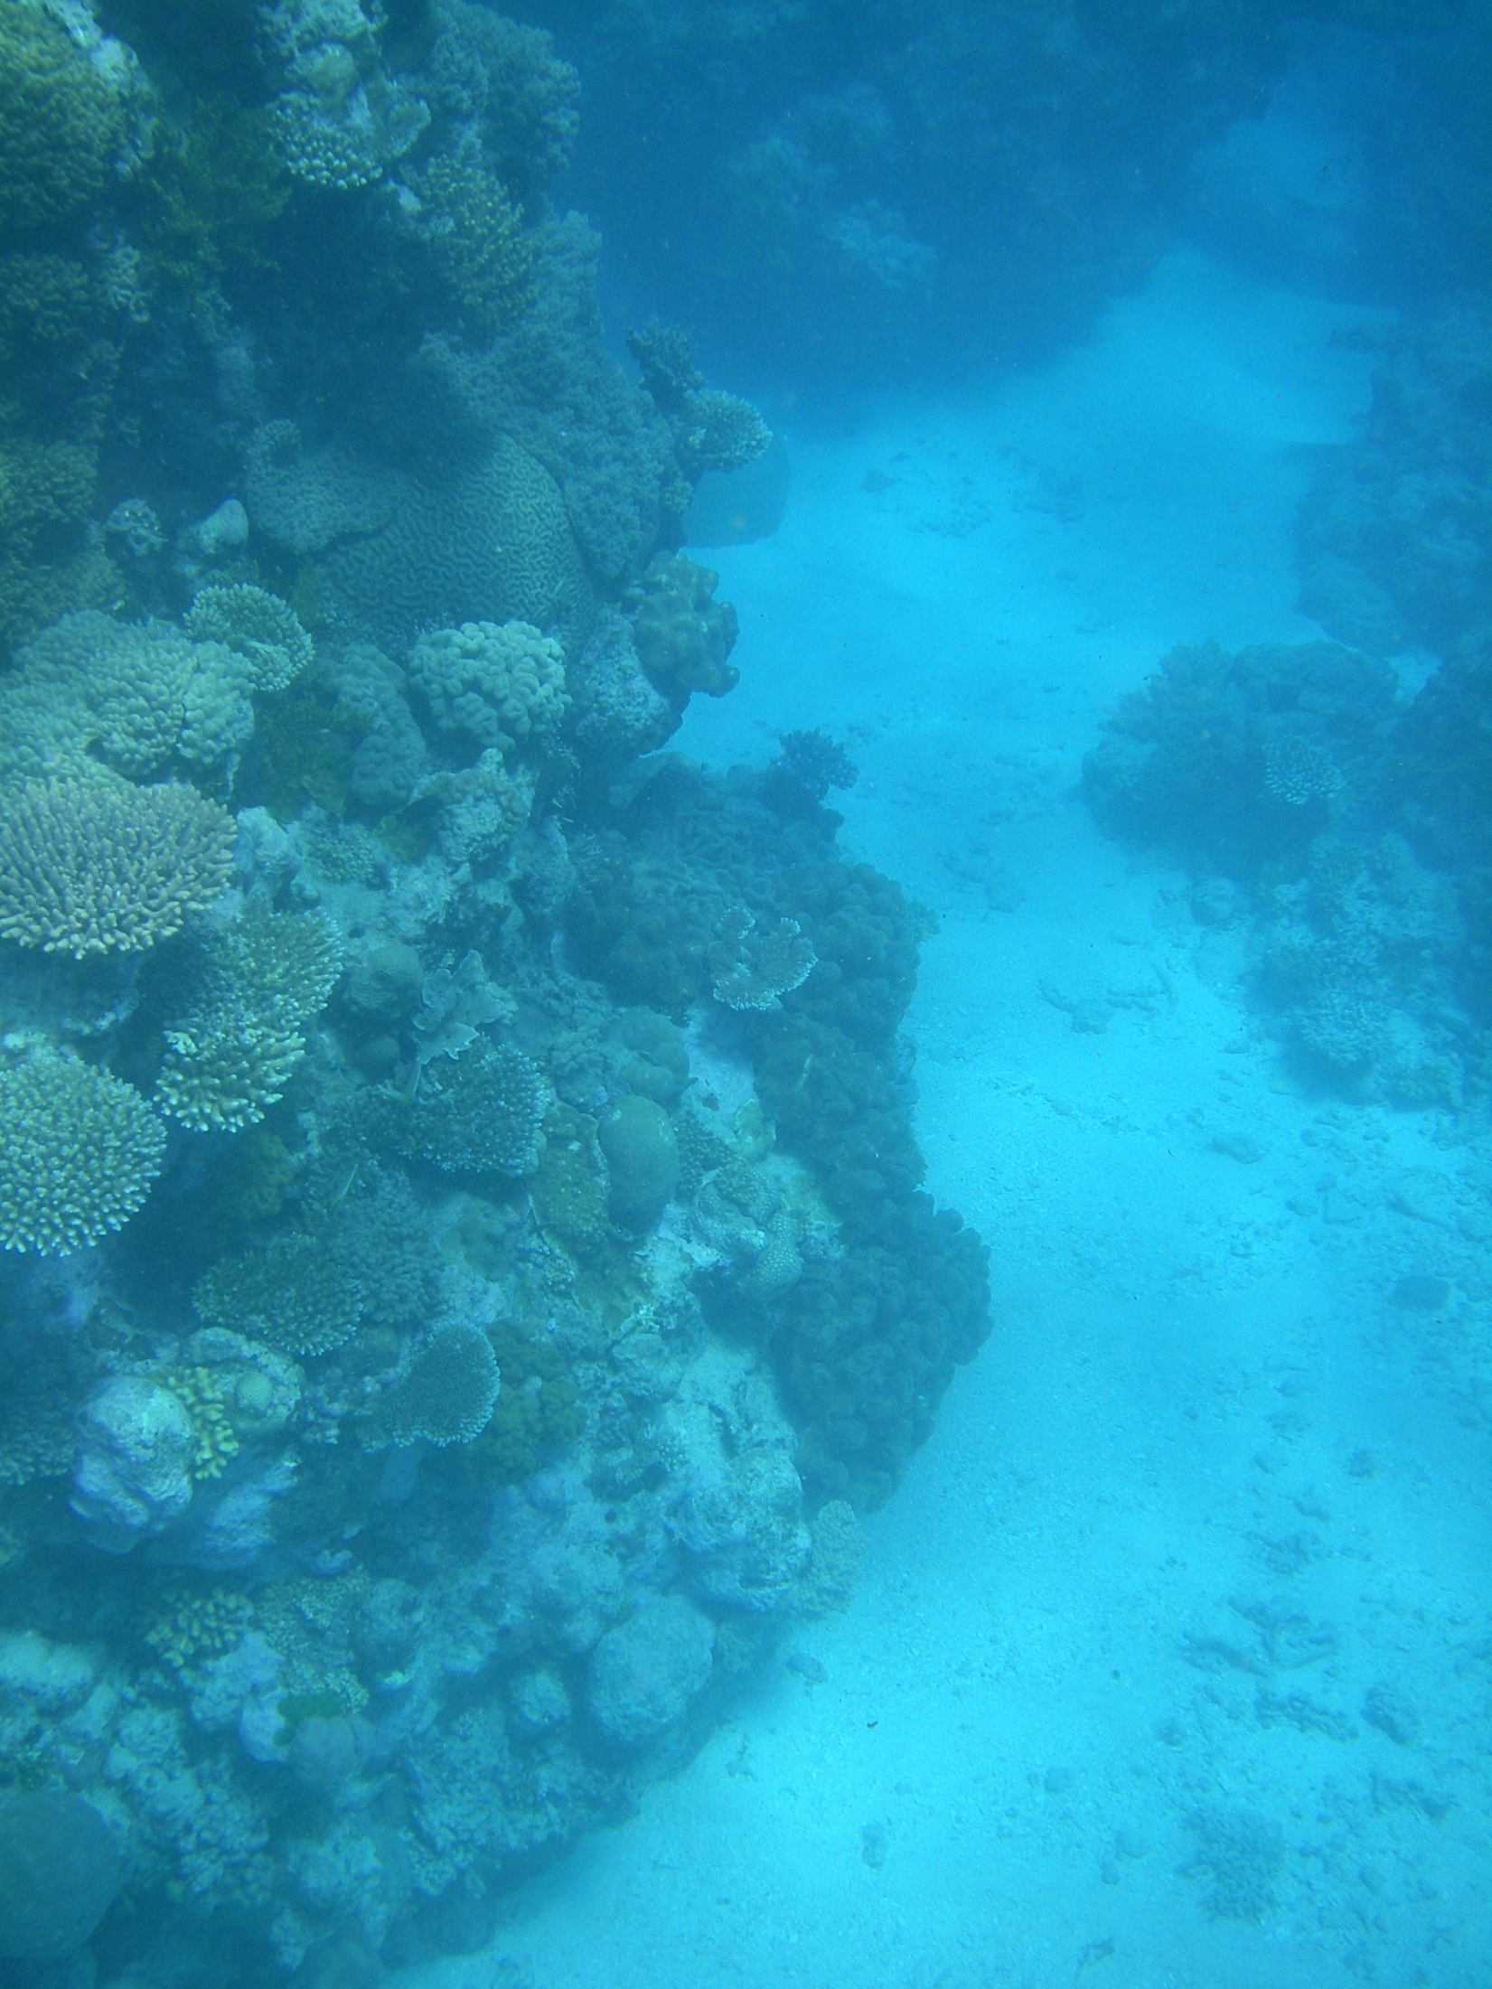



Climate impacts on hydrodynamics and sediment dynamics at reef islands
Ali Golshani*, Tom Baldock, David Callaghan, Peter Nielsen
Peter Mumby, Megan Saunders, Javier Patino, Stuart Phinn, Sarah Hamylton
Theme 10A: Modeling Reef Futures
^{9 July 2012}

Slide 2
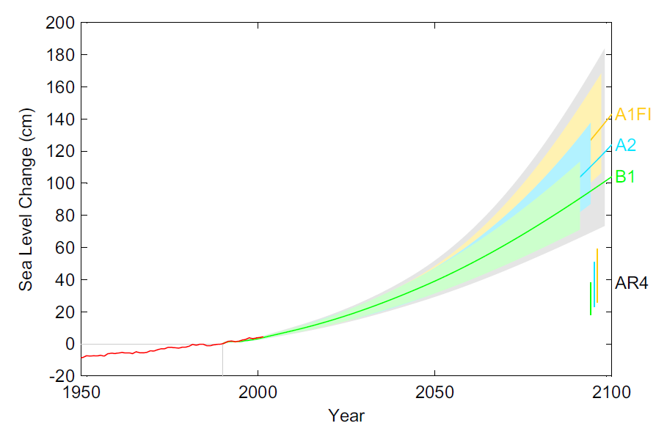

How does climate change alter island reef protection? directly and indirectly
Sea Level Rise
Water depth over reef determines wave energy dissipation (Sheppard et al. 2005, Madin et al. 2006, Storlazzi et al. 2011)
Deeper water allows greater wave energy to propagate over reef
Beach erosion
&
Coral breakage
Source: Vermeer (2009)

Slide 3
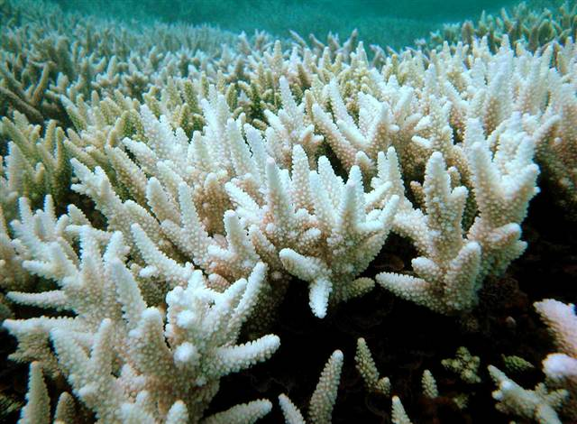
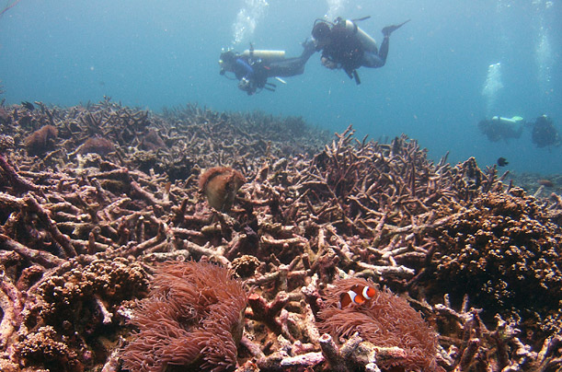
Climate change alters reef protection directly and indirectly
Coral DOES keep in pace with SLR ?
Coral DOES NOT keep pace?
Coral dies/erodes ?
No effect
Deeper water (relative SRL)
Coral reefs survive, beach suffers
Pseudo SLR & Increased sediment supply
(for sediment budget = partial buffering)
Source: Surf spots GPS website
Source: Surf spots GPS website

Slide 4
Research Objectives
Examine effects of:
  Water depth (SLR)
  Wind and wave climate
  Surface roughness (proxy for top reef condition)
  Bathymetric profile
  on hydrodynamic conditions [wave height, wave period and URMS (currents)] in top reef, lagoon and shoreline

Slide 5
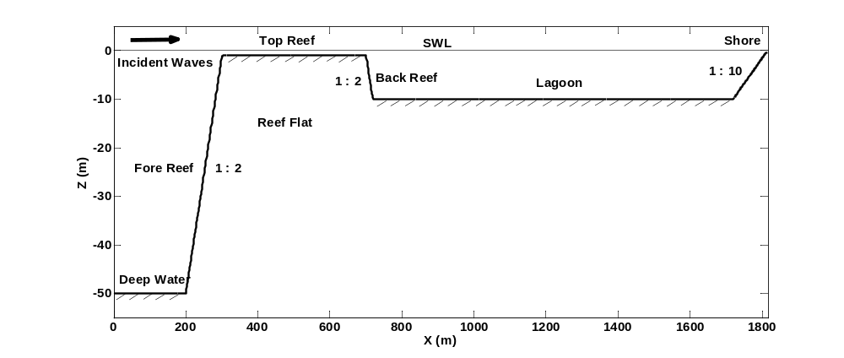
A simplified reef profile for GBR
Var.
Var.
Var.
Var.
Increased sediment supply (partial buffering)
Different values of top reef and lagoon width and depth are considered (540 varying bathymetries)

Slide 6
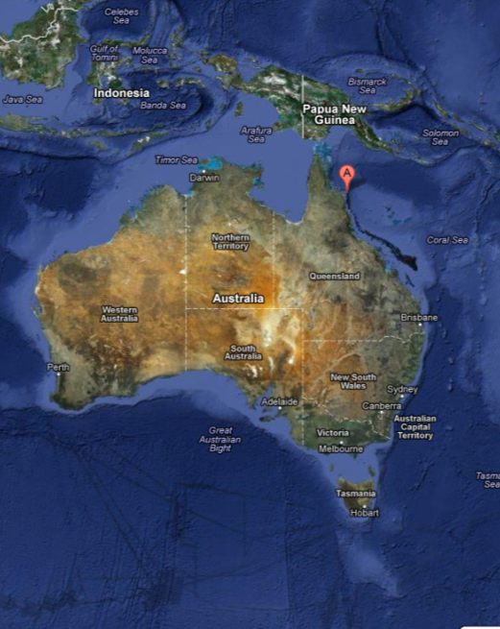
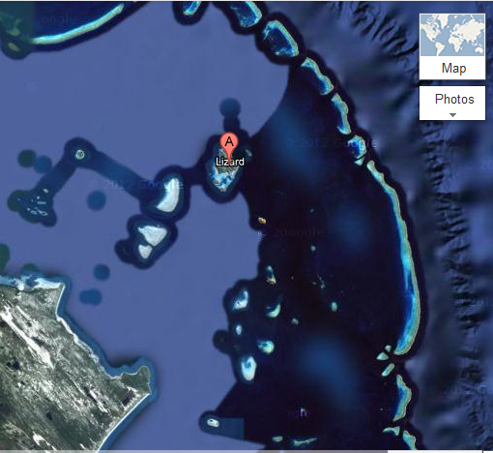
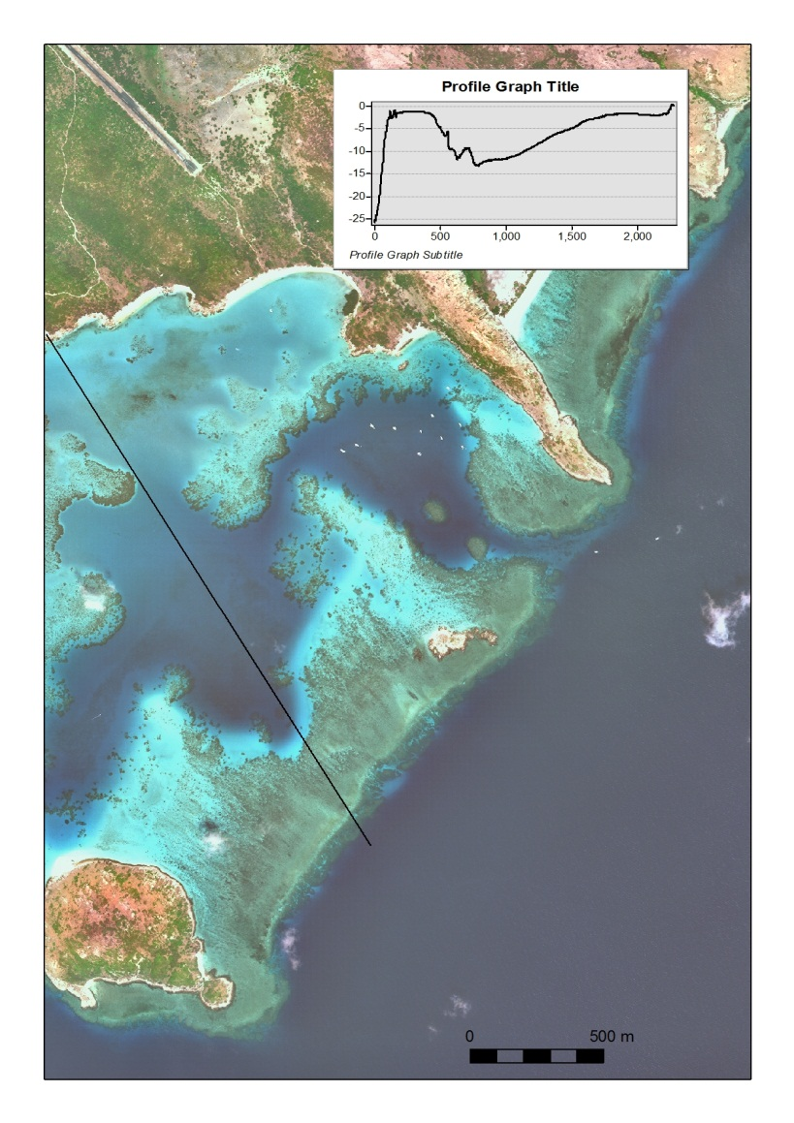
Base Profile
(Lizard Island)
The most representative of the main reef
(Corresponds to bathy No.144 out of 540)
Reef surface roughness (Nelson, 1996):
Kn=0.04m for smooth
Kn=0.1m for rough
Real
1m
10m
Simplified
400m
1000m
Notes:
The base profile used for comparison in this study has top reef width of 400m, depth of 1m, lagoon width of 1000m, and depth of 10m.
This profile is assumed to be the most representative of the main reef at Lizard Island according to the available profile survey data in the area.

Slide 7
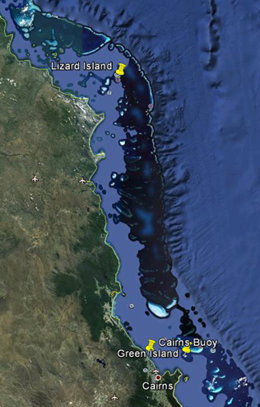
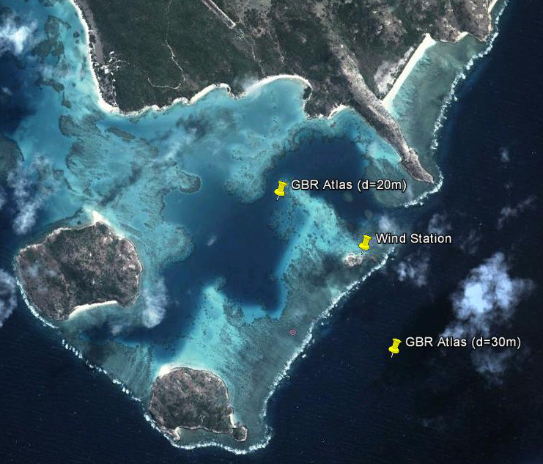
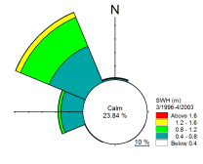
Wave and wind climate
Data Sources:
GBR wind and wave Atlas (Hardy, 2000): 1996-2000, dt=1hr, dx=1500m
Cairns wave buoy: 1975-present
Lizard Island wind station: Aug. 2010 - Apr. 2011 (8 months)
Cape Flattery wind station: June. 2003 - present
Green Island wind station: 1993 - present
Cape Flattery
240 km
Lizard Island
wave dir.
Notes:
The base profile used for comparison in this study has top reef width of 400m, depth of 1m, lagoon width of 1000m, and depth of 10m.
This profile is assumed to be the most representative of the main reef at Lizard Island according to the available profile survey data in the area.

Slide 8
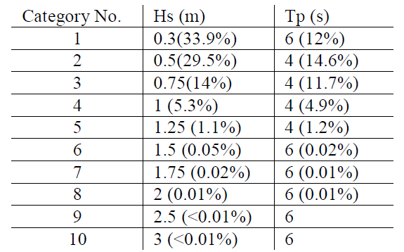
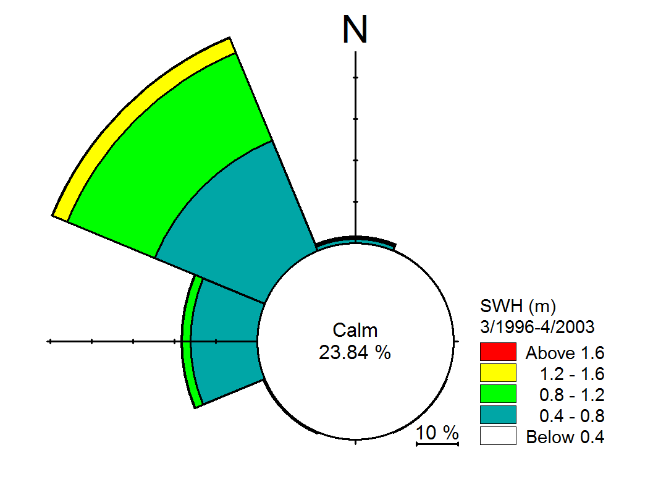
Wave classification
Wave clustering and percentage of occurrence
Typical condition
Extreme condition
Notes:
The base profile used for comparison in this study has top reef width of 400m, depth of 1m, lagoon width of 1000m, and depth of 10m.
This profile is assumed to be the most representative of the main reef at Lizard Island according to the available profile survey data in the area.

Slide 9
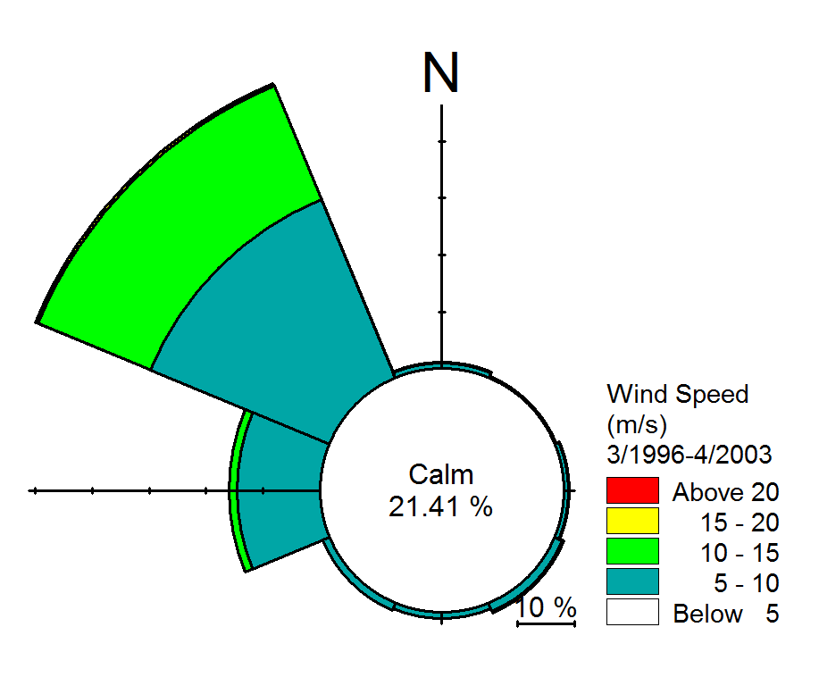
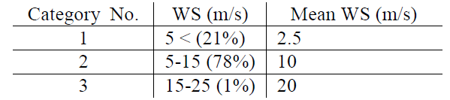
Wind Classification
Wind clustering and percentage of occurrence
Typical condition
Extreme condition
SLR scenario
Change in water depth = SLR + coral performance (accretion or erosion)
0 cm Coral growth keeps up with SLR
25cm
50 cm Corals do not keep up with SLR
1m
Notes:
The base profile used for comparison in this study has top reef width of 400m, depth of 1m, lagoon width of 1000m, and depth of 10m.
This profile is assumed to be the most representative of the main reef at Lizard Island according to the available profile survey data in the area.

Slide 10
SWAN model
A third-generation wave model (Booij et al., 1996)
Assumptions:
Friction : Madsen formulation (1988)
Breaking : Battjes and Janssen formulation (1978)
Triad interaction and wave setup : enabled
Quadruplet interaction: enabled only for wind condition
Wind and waves are in the direction of the reef profile
Wind is constant over the whole domain
Spreading index for wave parametric BC : 2
Model resolution = 5m (optimum)
Scenarios:
For different bathymetries
  top reef depth and width
  lagoon depth and width
  surface roughness
different climate condition
  wave, wind and sea level rise
129600 different cases of the 1D model
Notes:
The base profile used for comparison in this study has top reef width of 400m, depth of 1m, lagoon width of 1000m, and depth of 10m.
This profile is assumed to be the most representative of the main reef at Lizard Island according to the available profile survey data in the area.

Slide 11
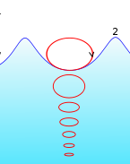
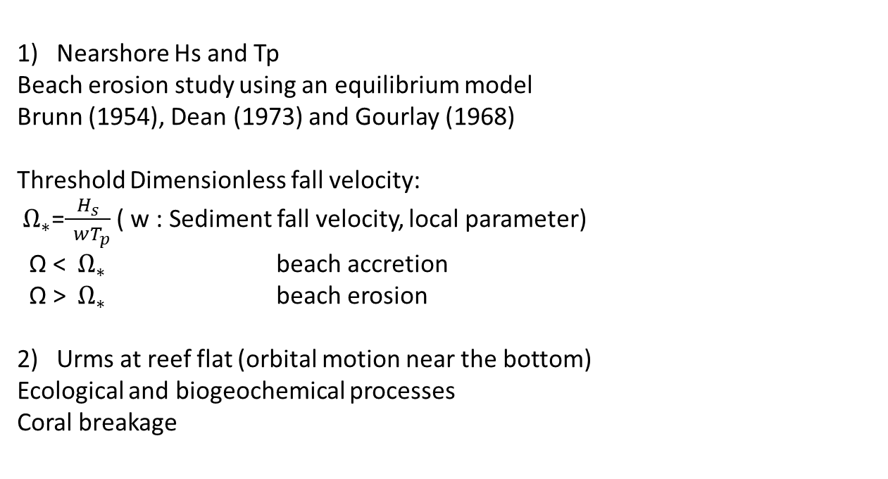
Important model outputs
Nearshore Hs and Tp
Beach erosion study using an equilibrium model
Brunn (1954), Dean (1973) and Gourlay (1968)
Threshold Dimensionless fall velocity:
${ Ω}_{∗}$=$\frac{H_{s}}{ wT_{p}}$ ( w : Sediment fall velocity, local parameter)
Ω < ${ Ω}_{∗}$ beach accretion
Ω > ${ Ω}_{∗}$ beach erosion
Urms at reef flat (orbital motion near the bottom)
Ecological and biogeochemical processes
Coral breakage
Notes:
The base profile used for comparison in this study has top reef width of 400m, depth of 1m, lagoon width of 1000m, and depth of 10m.
This profile is assumed to be the most representative of the main reef at Lizard Island according to the available profile survey data in the area.

Slide 12
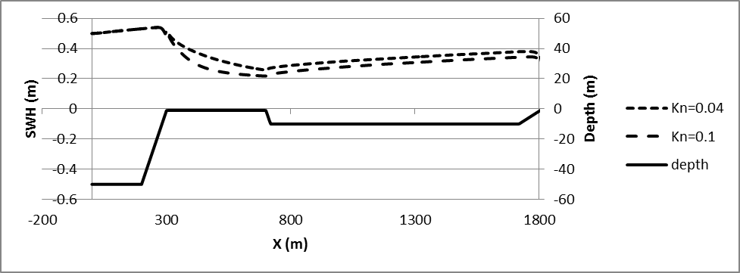
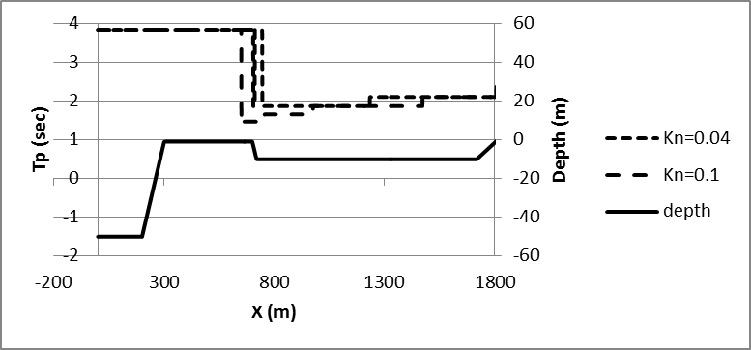
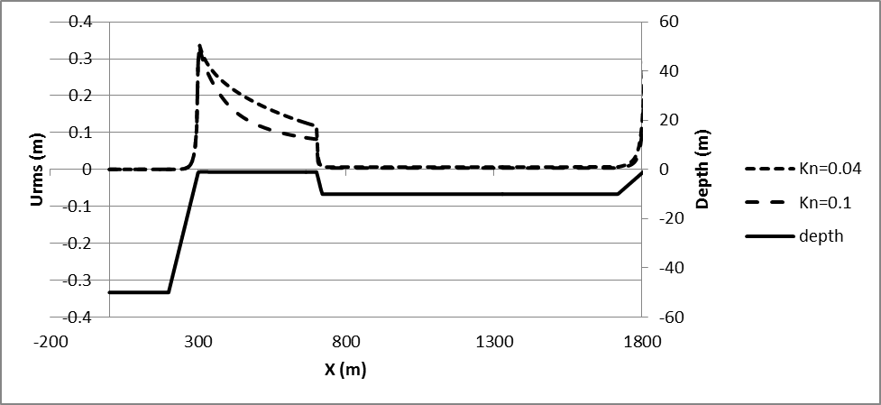
Coral roughness effect
(Hs=0.5m, WS=10m/s, base profile)
Rougher coral, smaller waves
Rougher coral,
smaller Urms
Rougher surface Higher energy dissipation Less Hs & Urms
Coral mortality rate & species distribution affect surface roughness
Notes:
The base profile used for comparison in this study has top reef width of 400m, depth of 1m, lagoon width of 1000m, and depth of 10m.
This profile is assumed to be the most representative of the main reef at Lizard Island according to the available profile survey data in the area.

Slide 13
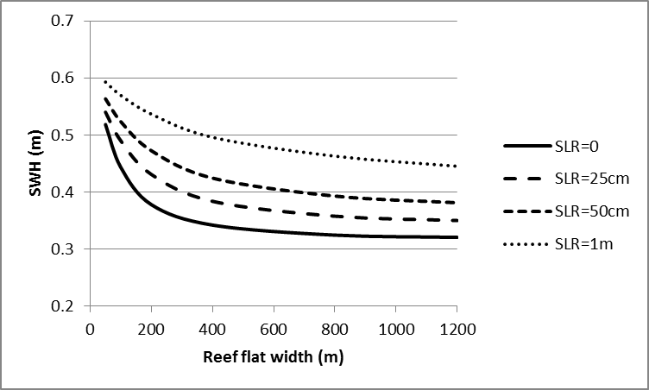
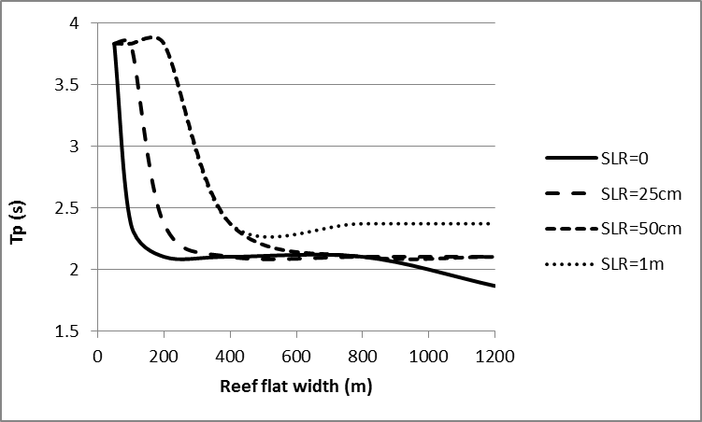
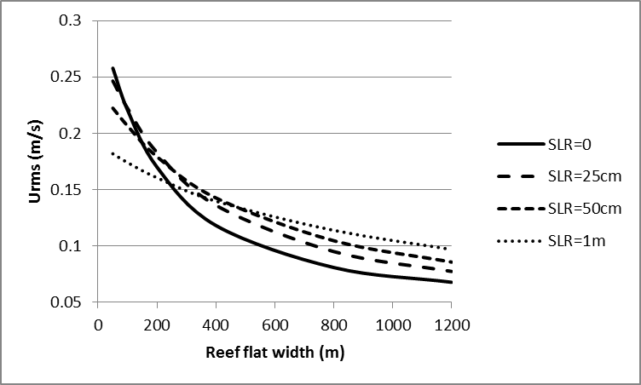
Reef flat width effect
(Hs=0.5m, WS=10m/s, rough reef)
Wider flat,
smaller Hs
Wider flat,
smaller Tp
Base Profile
Wider flat,
smaller Urms
Notes:
The base profile used for comparison in this study has top reef width of 400m, depth of 1m, lagoon width of 1000m, and depth of 10m.
This profile is assumed to be the most representative of the main reef at Lizard Island according to the available profile survey data in the area.

Slide 14
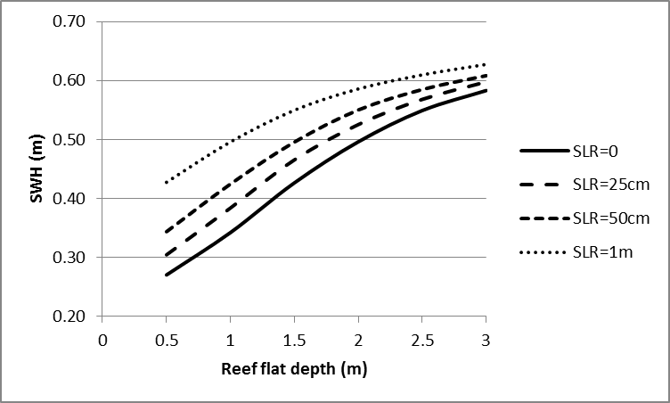
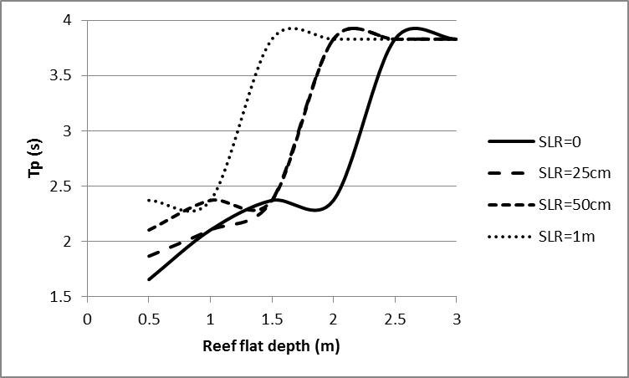
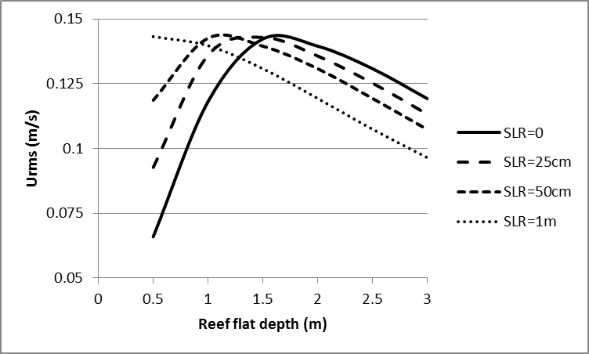
Reef flat depth effect
(Hs=0.5m, WS=10m/s, rough reef)
Deeper flat,
larger Hs
Deeper flat,
larger Tp
Base Profile
Deeper flat,
smaller Urms
then larger Urms
Notes:
The base profile used for comparison in this study has top reef width of 400m, depth of 1m, lagoon width of 1000m, and depth of 10m.
This profile is assumed to be the most representative of the main reef at Lizard Island according to the available profile survey data in the area.

Slide 15
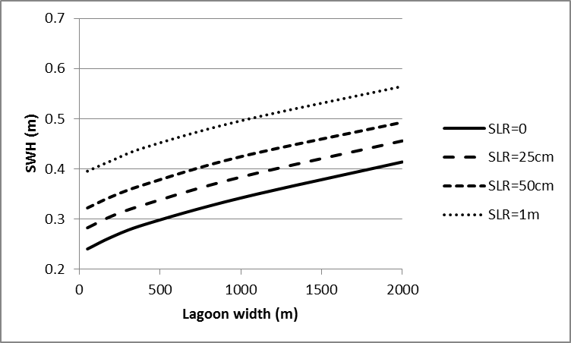
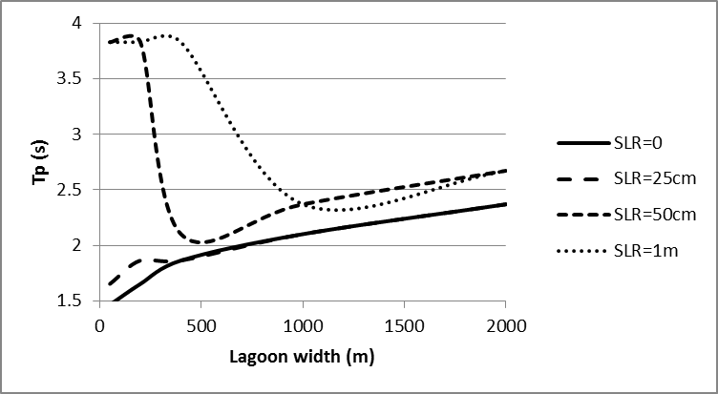
Lagoon width effect
(Hs=0.5m, WS=10m/s, rough reef)
Wider lagoon,
larger Hs
Base Profile
Wider lagoon More wind fetch Larger waves
Notes:
The base profile used for comparison in this study has top reef width of 400m, depth of 1m, lagoon width of 1000m, and depth of 10m.
This profile is assumed to be the most representative of the main reef at Lizard Island according to the available profile survey data in the area.

Slide 16
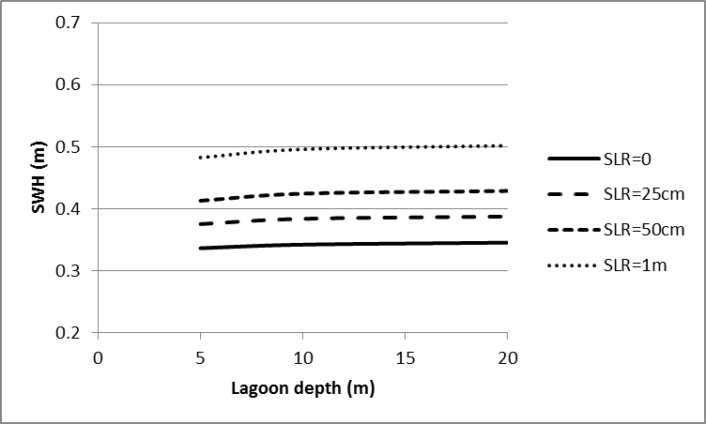
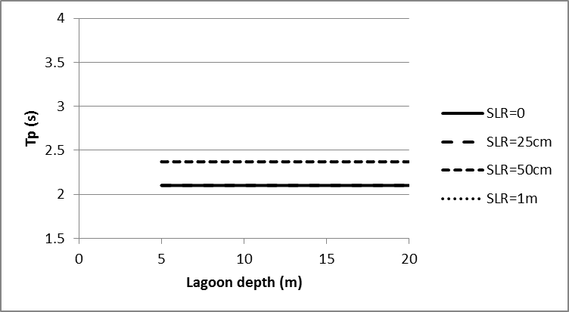
Lagoon depth effect
(Hs=0.5m, WS=10m/s, rough reef)
Deeper lagoon,
insignificant
Base Profile
Lagoon depth, insignificant, reef flat is a key parameter
Notes:
The base profile used for comparison in this study has top reef width of 400m, depth of 1m, lagoon width of 1000m, and depth of 10m.
This profile is assumed to be the most representative of the main reef at Lizard Island according to the available profile survey data in the area.

Slide 17
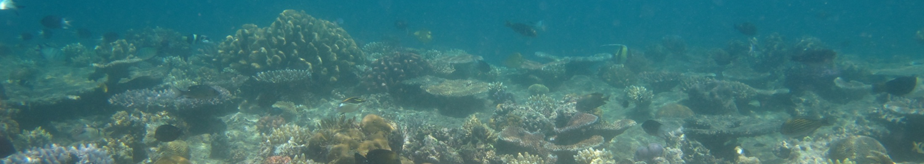
Summary
Global warming changes reef flat depths and roughness.
Urms & nearshore Hs & Tp change, accordingly.
Ecological processes on coral reefs and longshore sediment transport at the shore will be affected.
Effects will be site specific, e.g. a narrow reef responds differently to a wide reef, and deeper reefs have different response to shallow reefs.
This method would provide curves useful to determine SLR influence for a wide range of reef bathymetry, as well as changes to existing bathymetry at a particular reef.
Notes:
The base profile used for comparison in this study has top reef width of 400m, depth of 1m, lagoon width of 1000m, and depth of 10m.
This profile is assumed to be the most representative of the main reef at Lizard Island according to the available profile survey data in the area.

Slide 18
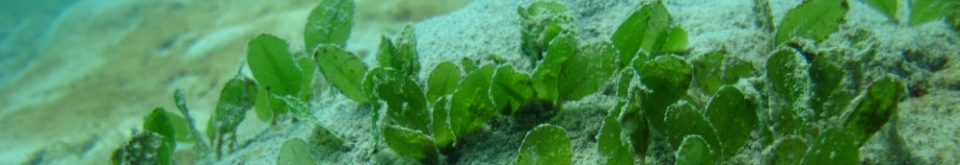
Acknowledgements
Global Change Institute Fund
Liu Mason (University of Tasmania) for GBR wind and wave Atlas
Jim Waldron (Queensland Department of Environment and Resource
Management, DERM) for Cairns buoy data

Slide 19
Contact:
Ali Golshani
School of Civil Engineering
University of Queensland, Australia
a.golshani@uq.edu.au
Photo: Naomi Edwards,
Agincourt Reef, Nov. 2011

